Slide 1
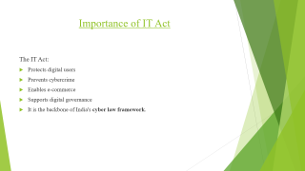
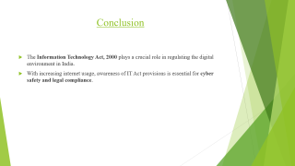
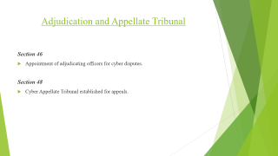
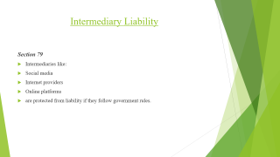
Information Technology Act, 2000
(With Important Sections Reference)
PRESENTED BY-
Balkrishna Kumar
Assistant professor

Slide 2
Topic: Information Technology Act, 2000
Subject: Cyber Law / Cyber Security
The Information Technology Act, 2000 is India's primary law dealing with cybercrime, electronic commerce, digital signatures, and online security.

Slide 3
Introduction
Information technology(IT) is a set of related field that encompass computer system, software programming languages and data and information processing and storage.
Information Technology(IT), is the use of technology to manage, process, protect and exchange information.
It is a broad field that includes the use of hardware, software, services and infrastructure to deliver information using voice, data and video.
Act is a formal decision, law or the like, by a legislature, ruler, court, other authority; decree; statute; judgement, resolve or award:
Information Technology Act 2000 is a primary law in India dealing with cybercrime and electronic commerce
Secondary or subordinate legislation to the IT Act includes the Intermediary Guidelines Rules 2011 and The Information Technology( Intermediary Guidelines and Digital Media Ethics Code) Rules 2021.

Slide 4
Brief Sketch about IT Act 2000
Citation : Information Technology Act, 2000
Enacted by : Parliament of India
Enacted : 9 June 2000
Assented to : 9 June 2000
Signed : 9 June 2000
Commenced : 17 Oct 2000
Introduced by : Pramod Mahajan (Minister of Communication and
Information Technology)
Amendment : One Time in the year 2008(IT Amendment Act 2008)
Related Legislation : IT Rules 2021

Slide 5
Brief Sketch about IT Act 2000
Total no of chapters : 13
No of Schedules : 04
No of Sections : 94
Framework : Legal Framework for E- Governance
Legal Recognition : Electronic Records and Digital signature
Note: The Act also amended various sections of the Indian Penal Code, 1860, the Indian Evidence Act 1872, The Banker’s Book Evidence Act 1891 and The RBI Act 1934

Slide 6
Important Information about IT Act 2000
There was insufficient cyber laws to deal with cyber crime
Model law on E- commerce (MLEC) was proposed by United Nation Commission on International Trade law (UNCITRAL)
It was adopted in the year 1996
It was also adopted by General Assembly of United Nations by passing a resolution on 30 jan 1997
India was a founder member of UNCITRAL and also a signatory to this model law and hence India had to enacted the IT Act 2000
The Act was amended in 2008 which came into force from 27 Oct. 2009

Slide 7
History
It is the Primary Law in India which deals with the It Act and E- Commerce
In India the Bill was finalised by a Group of officials headed by Ministers of Information Technology Mr. Pramod Mahajan
It was passed in the Budget session of 2000 and was signed by President Shree K R Narayanan on 9 June 2000
It provides legal Framework for Electronic Governance by giving recoginition to Digital Signature and Electronic Records.

Slide 8
Structure of IT Act 2000
IT Act 2000 Contains 94 sections divided in 13 chapters and 4 schedules
This act was further amended in 2008
Section 91,92,93 and 94 and Schedule 3 and 4 were omitted under this amendment
In 2017 no of section were omitted and changed mainly in chapter 10 by the much debated finance act of 2017 which merged Cyber Appellate Tribunal with the Telecom Dispute Settlement and appellate tribunal
It also amended various sections of IPC 1860, IEA 1872,Bankers Book Evidence Act, RBI Act 1934 to make them complaints with new technologies

Slide 9
Preamble of IT Act 2000
The preamble of The Information Technology Act 2000 states that the act was enacted to :
Provide Legal Recognition for Electronic transaction, also known as “Electronic Commerce”
Promote the Growth of electronic transactions.
Facilitate E- Governance.
Prevent Computer based crimes.
Ensures Security practices and procedures.

Slide 10
Objectives of IT Act 2000
1. Legal recognition to electronic documents (Section 4)
2.Legal recognition of digital signatures (Section 5)
3.Facilitate electronic filing with government (Section 6)
4.Prevent cybercrime and fraud
5.Promote secure digital transactions

Slide 11
Legal Recognition of Electronic Records
Section 4
Electronic records are legally valid just like paper documents.
Example:
Email agreements
Online contracts
Digital certificates

Slide 12
Legal Recognition of Digital Signatures
Section 5
Digital signatures provide authentication and security for electronic documents.
Used in:
Online filing
E-governance
Digital agreements

Slide 13
E-Governance
Section 6
Government departments can:
Accept electronic documents
Issue licenses electronically
Maintain digital records
Promotes paperless governance.

Slide 14
Attribution and Acknowledgment
Important sections:
Section 11: Attribution of electronic records
Section 12: Acknowledgement of receipt
Section 13: Time and place of dispatch of electronic records
These sections regulate electronic communication.

Slide 15
Regulation of Certifying Authorities
Important provisions:
Section 17: Controller of Certifying Authorities
Section 18: Powers of Controller
Section 24: Suspension of Digital Signature Certificate
Section 25: Revocation of Digital Signature Certificate
These ensure the authenticity of digital signatures.

Slide 16
Cyber Offences and Punishment
Key offences under the IT Act:
Section 43
Unauthorized access to computer systems.
Punishment:
Compensation up to ₹1 crore or more depending on damage.
Section 65
Tampering with computer source documents.
Punishment:
Up to 3 years imprisonment or ₹2 lakh fine.
Section 66
Computer-related offences (hacking).
Punishment:
Up to 3 years imprisonment or ₹5 lakh fine.

Slide 17
Section 66B
Receiving stolen computer resource.
Punishment:
Up to 3 years imprisonment.
Section 66C
Identity theft.
Example:
Using someone else's password.
Punishment:
Up to 3 years imprisonment + ₹1 lakh fine.
Section 66D
Cheating by impersonation using computer resources.
Example:
Online fraud.
Punishment:
Up to 3 years imprisonment + ₹1 lakh fine.

Slide 18
Section 66E
Violation of privacy.
Punishment:
Up to 3 years imprisonment.
Section 66F
Cyber Terrorism.
Punishment:
Life imprisonment.

Slide 19
Obscene and Illegal Content
Section 67
Publishing obscene content online.
Punishment:
3–5 years imprisonment.
Section 67A
Publishing sexually explicit material.
Punishment:
5 years imprisonment.
Section 67B
Child pornography.
Punishment:
Up to 5 years imprisonment.

Slide 20
Powers of Government
Important sections:
Section 69: Power to intercept and monitor data
Section 69A: Blocking of websites
Section 69B: Monitoring of traffic data
Example: Blocking harmful or illegal websites.

Slide 21
Protection of Critical Information
Section 70
Protected systems (national security systems).
Unauthorized access is punishable.
Section 70B
Establishment of Indian Computer Emergency Response Team
CERT-In handles:
Cyber security incidents
Cyber threat response

Slide 22
Intermediary Liability
Section 79
Intermediaries like:
Social media
Internet providers
Online platforms
are protected from liability if they follow government rules.

Slide 23
Adjudication and Appellate Tribunal
Section 46
Appointment of adjudicating officers for cyber disputes.
Section 48
Cyber Appellate Tribunal established for appeals.

Slide 24
Importance of IT Act
The IT Act:
Protects digital users
Prevents cybercrime
Enables e-commerce
Supports digital governance
It is the backbone of India's cyber law framework.

Slide 25
Conclusion
The Information Technology Act, 2000 plays a crucial role in regulating the digital environment in India.
With increasing internet usage, awareness of IT Act provisions is essential for cyber safety and legal compliance.

